Slide 1

What A Disaster!
Building a classifier for Disaster Tweets Kaggle Competition

Slide 2


About Me
Translator and Linguist, 8200
BSc in Digital Sciences for High Tech and Linguistics,
Tel Aviv University
Avid cat lover
Looking for a job
Linkedin - Rotem Ecker

Slide 3
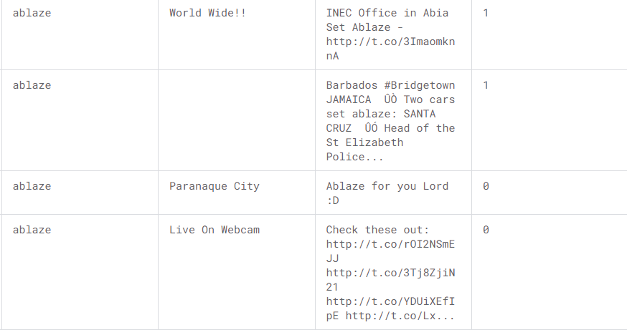
The Competition
Knowledge competition
Data contains 3 columns: keyword, location, text
7503 unique tweets
The locations are self reported
Best result: 100%
See more here
Notes:
Our goal was never to get to 100% accuracy, it was to try new things and gain some experience in the world of NLP

Slide 4
Example
keyword | location | text | target
ablaze | Birmingham | @bbcmtd Wholesale Markets ablaze http://t.co/lHYXEOHY6C | 1
ablaze | Est. September 2012 - Bristol | We always try to bring the heavy. #metal #RT http://t.co/YAo1e0xngw | 0
Notes:
1 means real disaster, 0 is not a disaster
Take note of the difference in location format

Slide 5

Feature Engineering
is_real_location using spacy NER
contains_hashtags
contains_urls
urls
Sentiment analysis (twitter-roberta, TextBlob)
Applying bertweets on the textual columns
Using TF-IDF on tweets
SVD to get most important component
Notes:
We wanted to use the URLs for text summerization, but we didn’t have the funds and time to do it
We used SVD to reduce all the arrays to a single number because we had a technical difficulty inserting a dataframe containing both ints and arrays to our models

Slide 6
Example 2.0
text @bbcmtd wholesale markets ablaze http://t.co/l...
is_real_location 1
contains_hashtags 0
contains_url 1
textblob_sentiment 2
transformer_sentiment 2
text we always try to bring the heavy. #metal #rt h...
is_real_location 0
contains_hashtags 1
contains_url 1
textblob_sentiment 1
transformer_sentiment 2
Notes:
Note that Birmingham was recognized by the Spacy NER, but Bristol as a part of a longer sentence was not
In the second tweet, you can also see the reason we kept both sentiment analyses – there were differences between their judgement

Slide 7
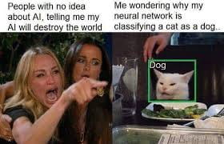
Classification Models
XGBoost
XGBoost - Features only
XGBoost - Texts only
SVM
5 layers Fully Connected NN
LLM (DistileBERT)
Full notebook

Slide 8
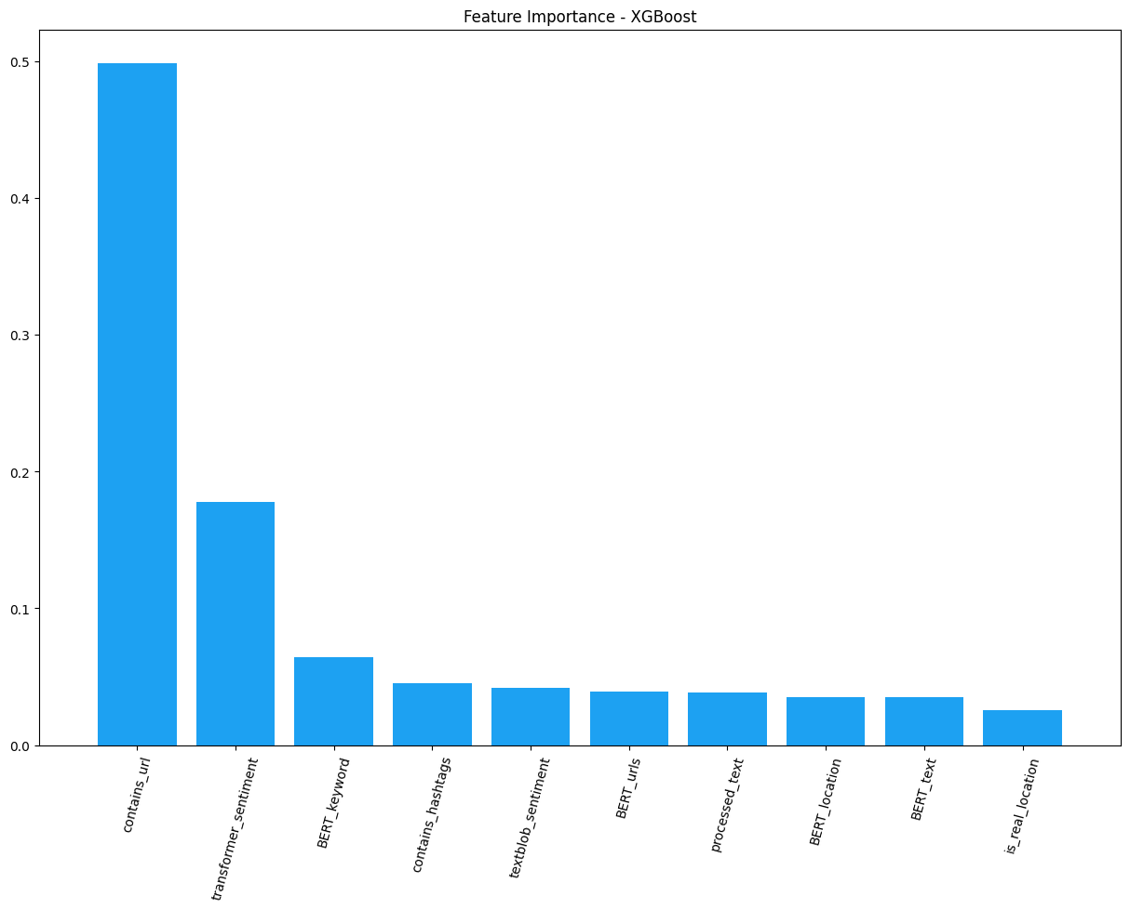
Feature Importance Comparison - XGBoost
The most important feature was contains_url
The least important was is_real_location

Slide 9
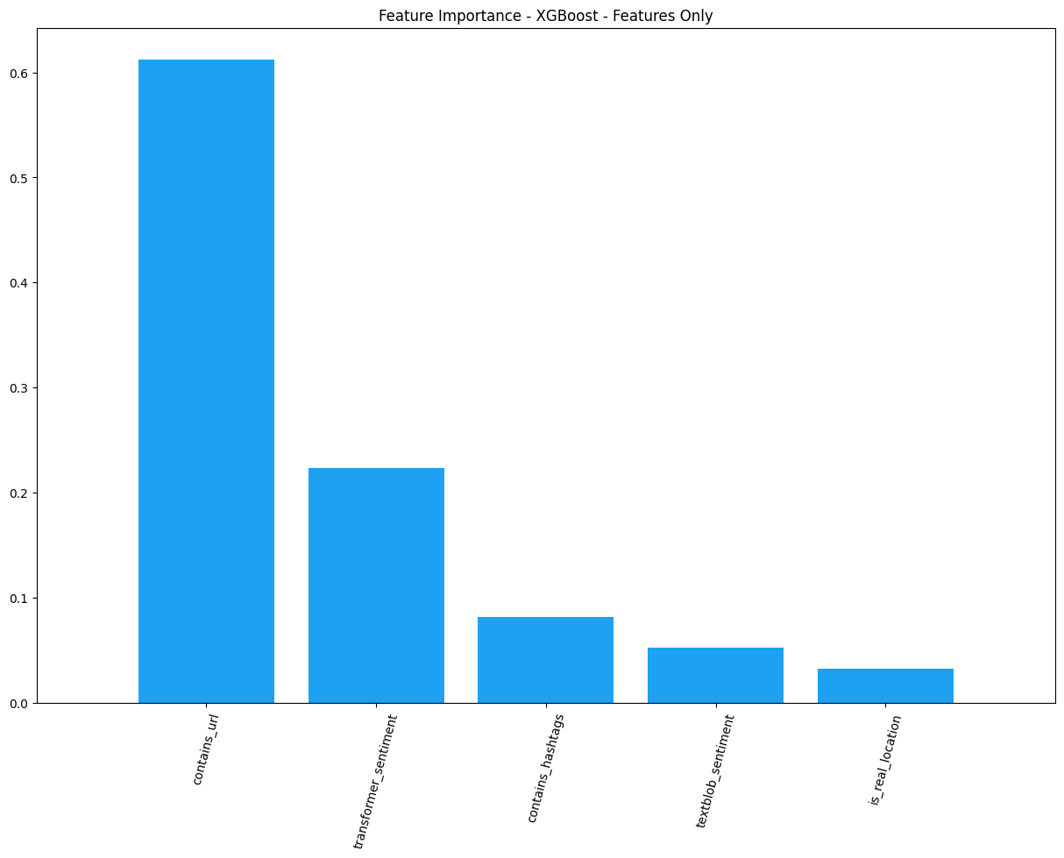
Feature Importance Comparison - XGBoost (Features)
It stayed the same

Slide 10
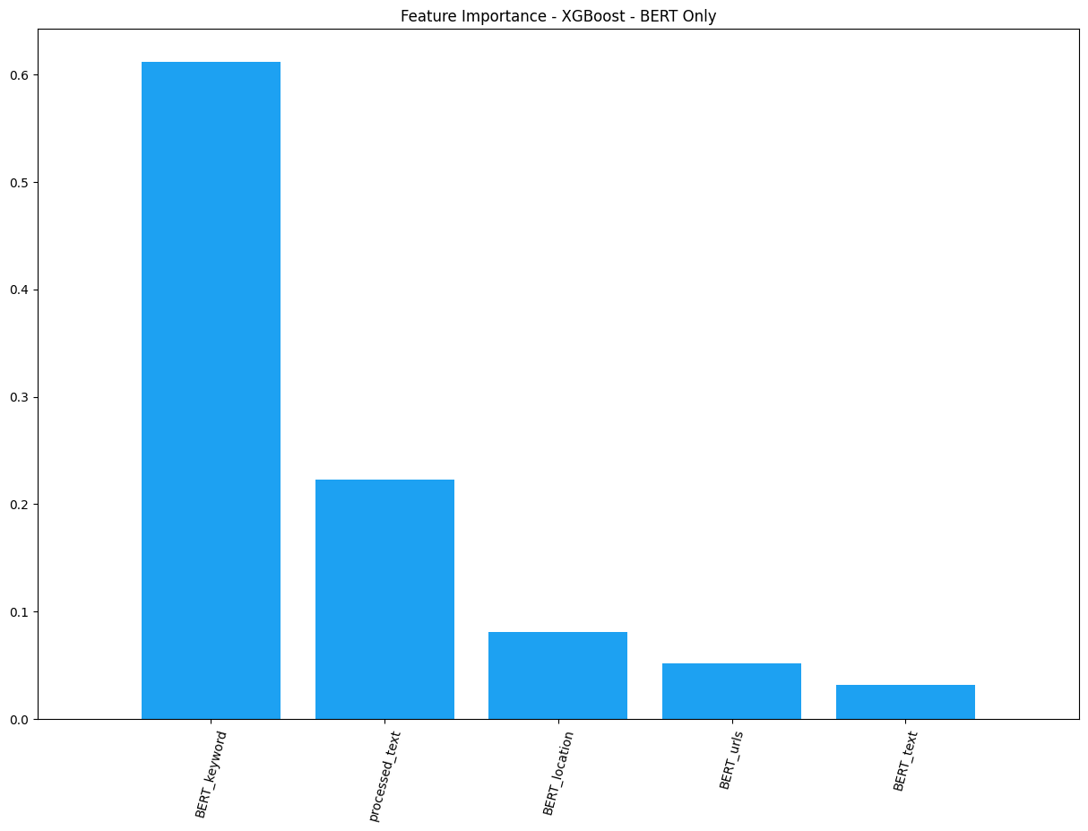
Feature Importance Comparison - XGBoost (Text)
The most important feature was keyword
The least important was the text itself

Slide 11
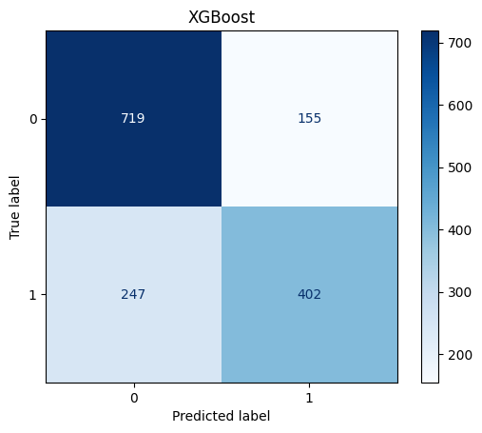
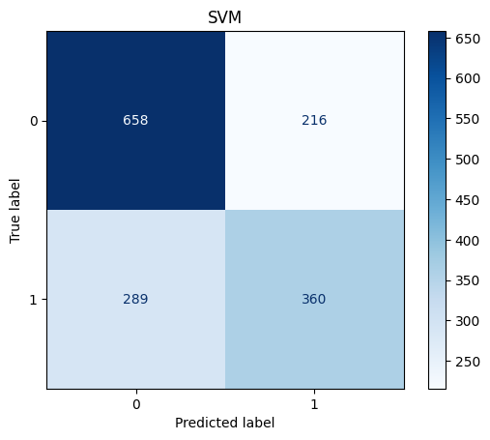
Confusion Matrices

Slide 12
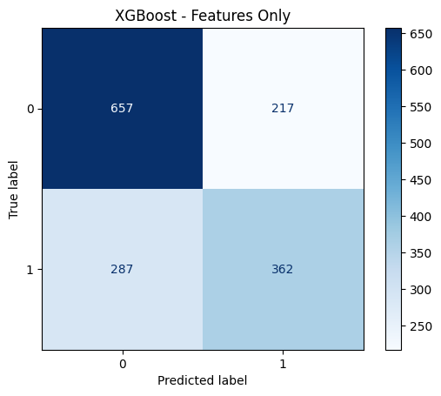

Confusion Matrices

Slide 13
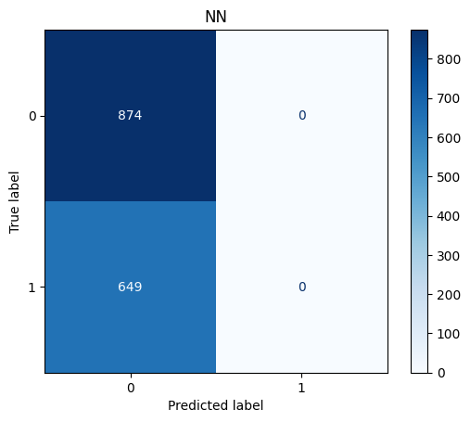
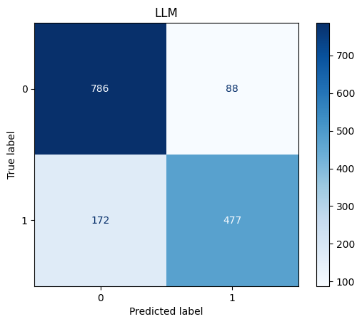
Confusion Matrices
Notes:
We had a bug in our NN, but didn’t have the time to fix it ☺

Slide 14
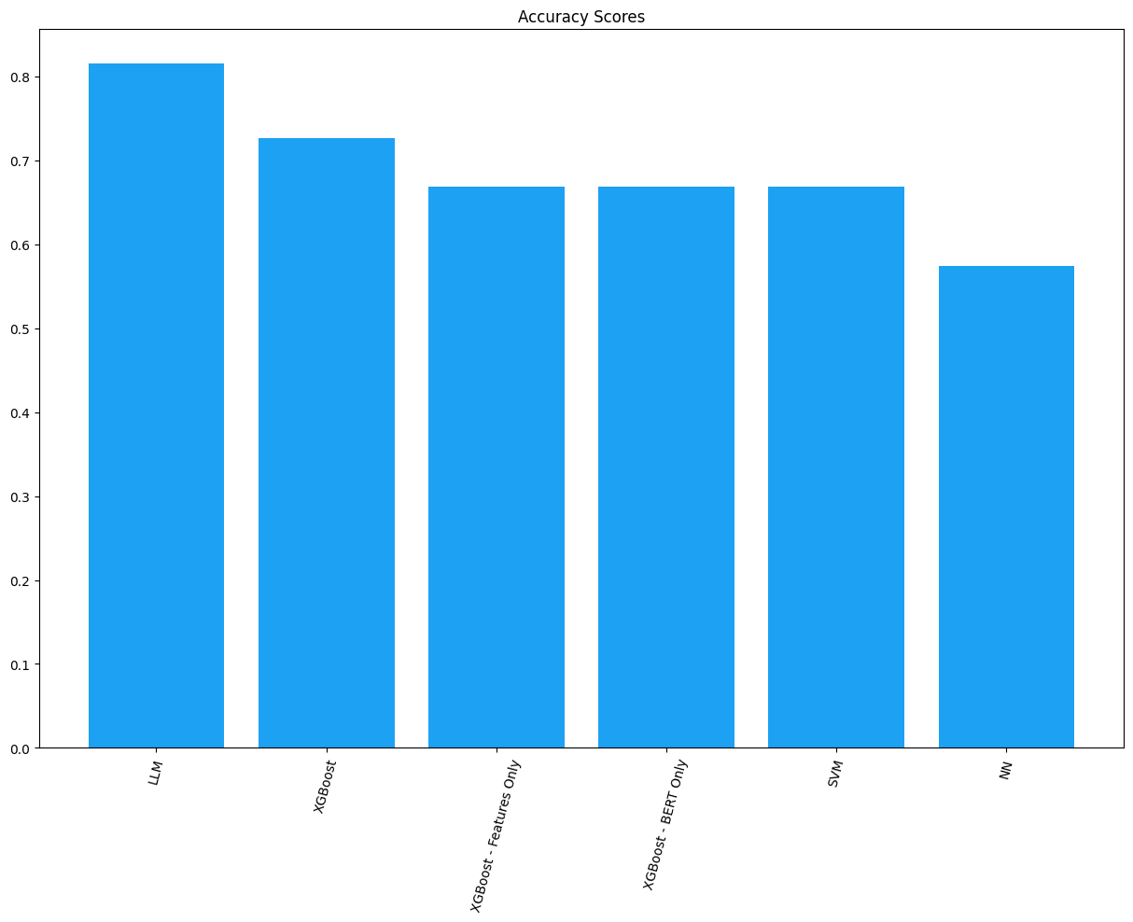
Accuracy

Slide 15
Questions?
Also, I’m still looking for a job

